Slide 1
System Modeling
Chapter 5-Software Engineering by Ian Sommerville

Slide 2
Content
Context models
Structural models
Behavioral models

Slide 3
System Modeling
System modeling is the process of developing abstract models of a system, with each model presenting a different view or perspective of that system.
System modeling has generally come to mean representing the system using some kind of graphical notation, which is now almost always based on notations in the Unified Modeling Language (UML)

Slide 4
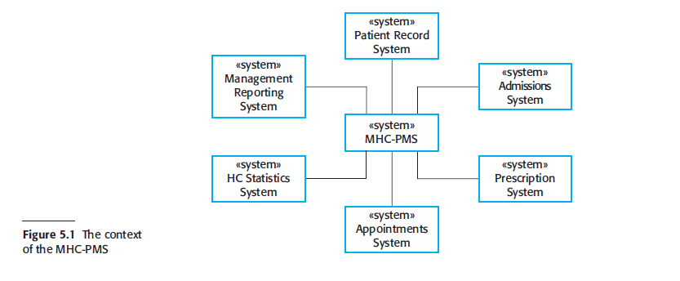
System Model

Slide 5
Static vs Dynamic Modeling
A structural perspective, where you model the organization of a system or the structure of the data that is processed by the system.
A behavioral perspective, where you model the dynamic behavior of the system and how it responds to events.

Slide 6
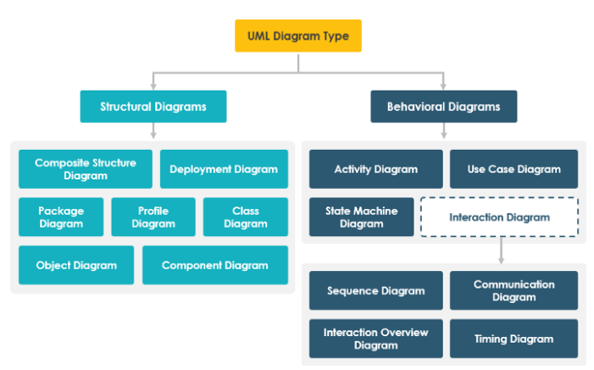

Slide 7
Static vs Dynamic Modeling
UML diagrams represent these two aspects of a system:
Structural (or Static) view: emphasizes the static structure of the system using objects, attributes, operations and relationships. It includes class diagrams and composite structure diagrams.
Behavioral (or Dynamic) view: emphasizes the dynamic behavior of the system by showing collaborations among objects and changes to the internal states of objects. This view includes sequence diagrams, activity diagrams, and state machine diagrams.

Slide 8
The Unified Modeling Language
The Unified Modeling Language is a set of 13 different diagram types that may be used to model software systems.
It emerged from work in the 1990s on object-oriented modeling where similar object-oriented notations were integrated to create the UML.
A major revision (UML 2) was finalized in 2004.
The UML is universally accepted as the standard approach for developing models of software systems.
Variants have been proposed for more general system modeling.

Slide 9

Use-case Diagram
A use case diagram is a graphical depiction of a user's possible interactions with a system.
A use case diagram shows various use cases and different types of users the system has and will often be accompanied by other types of diagrams as well

Slide 10
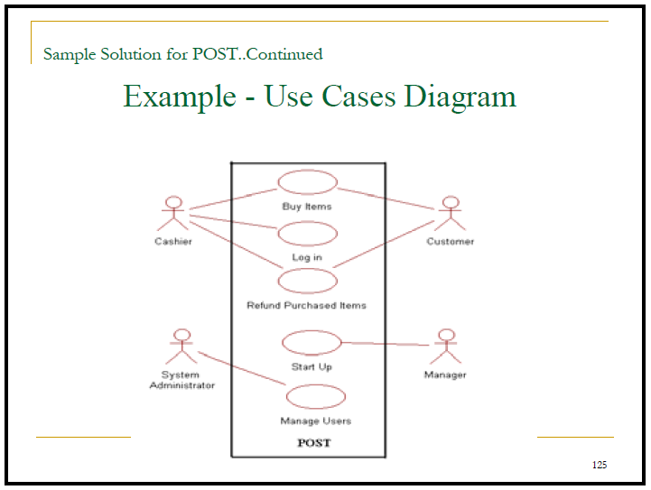

Slide 11
